Slide 1
mining Internet of Things Data -healthcare
Beiyu Lin

Slide 2
Challenges for AI in Healthcare
Dataset shift
Accidental fitting of confounders
Generalization to new populations
Unintended discriminatory bias
Susceptibility to adversarial attack or manipulation
Algorithmic interpretability is at an early stage but rapidly advancing
Notes:
https://bmcmedicine.biomedcentral.com/articles/10.1186/s12916-019-1426-2

Slide 3
Challenges for AI in Healthcare
Dataset shift
Notes:
https://bmcmedicine.biomedcentral.com/articles/10.1186/s12916-019-1426-2

Slide 4
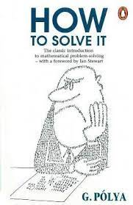
Dataset shift
Particularly important for electronic health records (EHRs)
All input data are generated within a non-stationary environment with shifting patient populations, where clinical and operational practices evolve over time.
That is, the distributions in training and testing are different

Slide 5
Data shift examples
Imagine that you want to design an algorithm to detect cancer. You collect data from healthy and sick people and you train your algorithm. It works fine, giving you high accuracy and you conclude that you are ready for a successful career in medical diagnostics. Not so fast.
The distributions that gave rise to the training data and those you will encounter in the wild might differ considerably. This happened to an unfortunate startup that some of us (authors) worked with years ago. They were developing a blood test for a disease that predominantly affects older men and hoped to study it using blood samples that they had collected from patients. However, it is considerably more difficult to obtain blood samples from healthy men than sick patients already in the system. To compensate, the startup solicited blood donations from students on a university campus to serve as healthy controls in developing their test. Then they asked whether we could help them to build a classifier for detecting the disease.
As we explained to them, it would indeed be easy to distinguish between the healthy and sick cohorts with near-perfect accuracy. However, that is because the test subjects differed in age, hormone levels, physical activity, diet, alcohol consumption, and many more factors unrelated to the disease. This was unlikely to be the case with real patients. Due to their sampling procedure, we could expect to encounter extreme covariate shift. Moreover, this case was unlikely to be correctable via conventional methods. In short, they wasted a significant sum of money.

Slide 6
Types of Data shift
Covariate shift
Prior probability shift
Concept drift

Slide 7
Covariate shift
Covariate shift is the change of distributions in one or more of the independent variables (input features).
Definition 1. Covariate shift is termed the situation where P_{trn}(Y|X)=P_{tst}(Y|X)
but P_{trn}(X) ≠P_{tst}(X)

Slide 8
detect covariate shifts
Create new variable with ones in train set and zeroes in test set.
Merge the two sets and shuffle randomly.
Split in new train-test at 80%-20%
For each single input variable:
Fit a simple classifier (e.g. Random Forests)
Predict ‘is_train’ variable
Calculate AUC
If AUC exceeds some threshold (e.g. 60%), feature displays data shift

Slide 9
Prior probability shift
input feature distributions remain the same but the distribution of the target variable changes.
Definition 2: Prior probability shift is termed the situation where P_{trn}(X|Y)=P_{tst}(X|Y) but P_{trn}(Y) ≠P_{tst}(Y)

Slide 10
Concept shift
A concept drift happens where the relations between the input and output variables change. So we are not anymore only focusing on X variables or only the Y variable but on the relations between them.
Definition 3. A concept drift is termed the situation where P_{trn}(Y|X) ≠ P_{tst}(Y|X).

Slide 11
Challenges for AI in Healthcare
Unintended discriminatory bias
Notes:
https://bmcmedicine.biomedcentral.com/articles/10.1186/s12916-019-1426-2

Slide 12
Unintended discriminatory bias
Racism embedded in US healthcare
In October 2019, an algorithm, to predict which patients would likely need extra medical care, used on more than 200 million people in US hospitals heavily favored white patients over black patients.
While race itself wasn’t a variable used in this algorithm, another variable highly correlated to race was, healthcare cost history.
The rationale was that cost summarizes how many healthcare needs a particular person has. For various reasons, black patients incurred lower health-care costs than white patients with the same conditions on average.

Slide 13
Unintended discriminatory bias
Steps:
Framing the Problem
Evaluating the Baseline Model
Comparing Models

Slide 14
Example
Frame a problem:
providing early health and financial counseling to patients expected to experience a prolonged length of stay (LOS) in an intensive care unit (ICU) ward.
we would like to ensure that resources are distributed among our patients fairly.
Baseline model:
use the patient's age, diagnosis, language, and the use of medical procedures during their stay to predict this value.
Outcome:
a binary prediction indicating whether or not the LOS for a given admission is greater than the mean.

Slide 15
1). Summer research assistantship (before March 15th)
2). HW1 (will be assigned on Feb. 25th)
3). Guest speaker on Thursday Feb. 24th
4). Course Project

Slide 16
Challenges for AI in Healthcare
Dataset shift
Accidental fitting of confounders
Generalization to new populations
Unintended discriminatory bias
Susceptibility to adversarial attack or manipulation
Algorithmic interpretability is at an early stage but rapidly advancing
Notes:
https://bmcmedicine.biomedcentral.com/articles/10.1186/s12916-019-1426-2

Slide 17
Why it happens
Small Sample Data for Bias and Fairness Problems

Slide 18
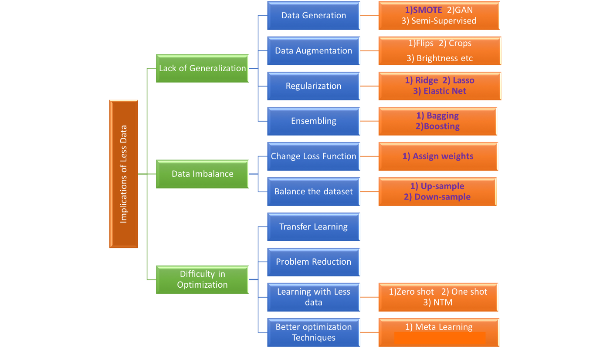
Small samples

Slide 19
Solutions
1). Change the loss function
2). Unbalanced data:
Model favors the majority class / label
Solutions: add weights to the losses corresponding to different classes
E.g., two classes / labels with data in the ration of 5:2, we can apply weights in the ratio 2:5 to the loss function calculation to make the data balanced.
Python package: scikit-learn: compute_class_weight

Slide 20
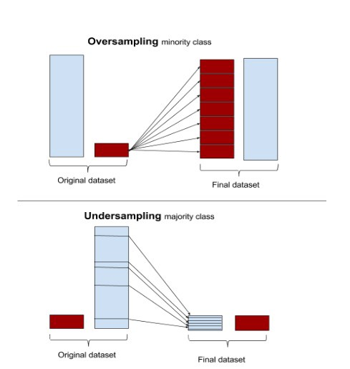
Solutions
3). Anomaly/change detection
e.g., fall detection;
Python package: scikit-learn
4). Up-sample or Down-sample

Slide 21
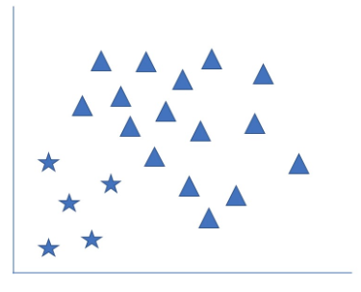
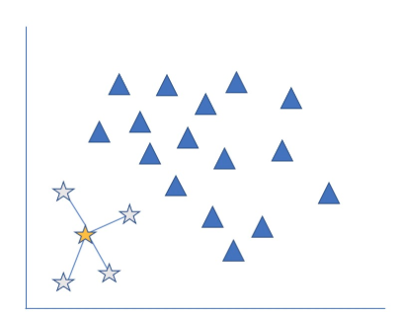
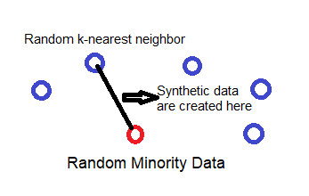
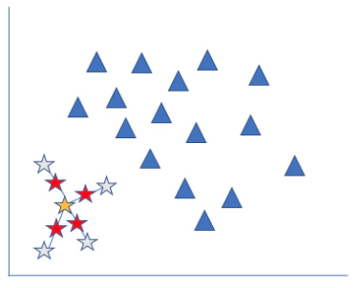
Solutions
5). Synthetic Minority Over-Sampling Technique (SMOTE)

Slide 22
generative adversarial network

Slide 23
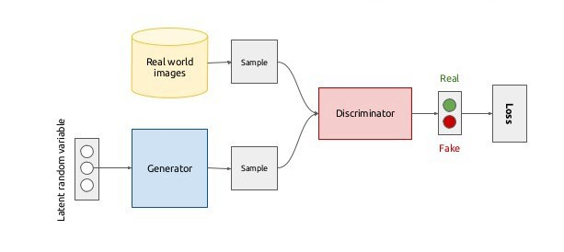
generative adversarial network

Slide 24
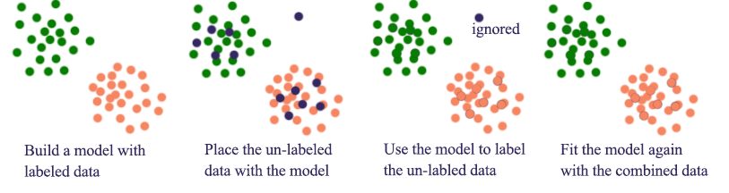
Semi-supervised learning

Slide 25
Solutions
Learn the Distribution
Generative Adversarial Neural Network
Semi-supervised learning (active learning)

